Slide 1
RIBs
A mobile architecture that scales together with the team
Gergely Orosz, Engineering Manager, Uber
29 Nov 2017

Slide 2
➜
Motivation
Overview of the Architecture
RIBs in Practice

Slide 3
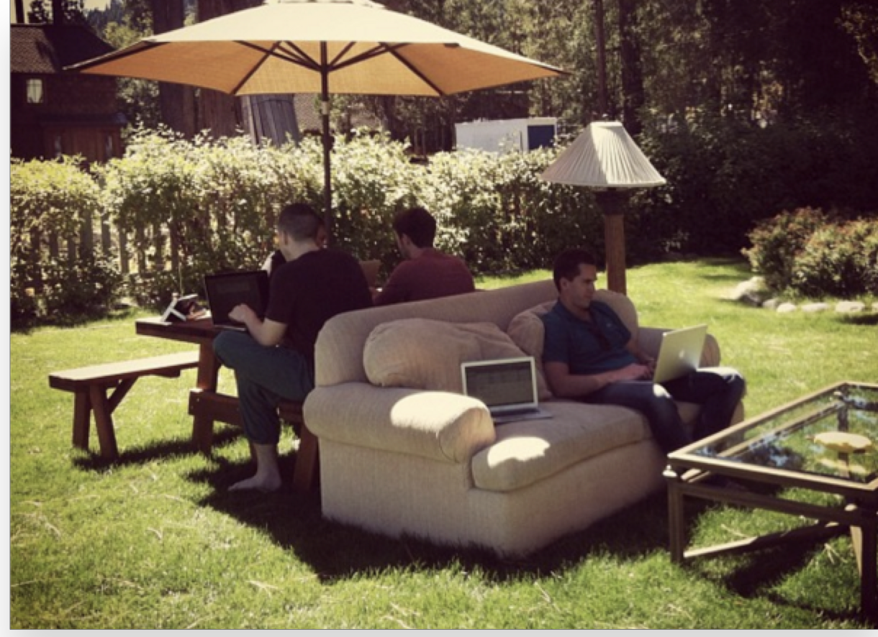
A Growing Team
5 years ago: Uber’s entire mobile team is hard at work.

Slide 4
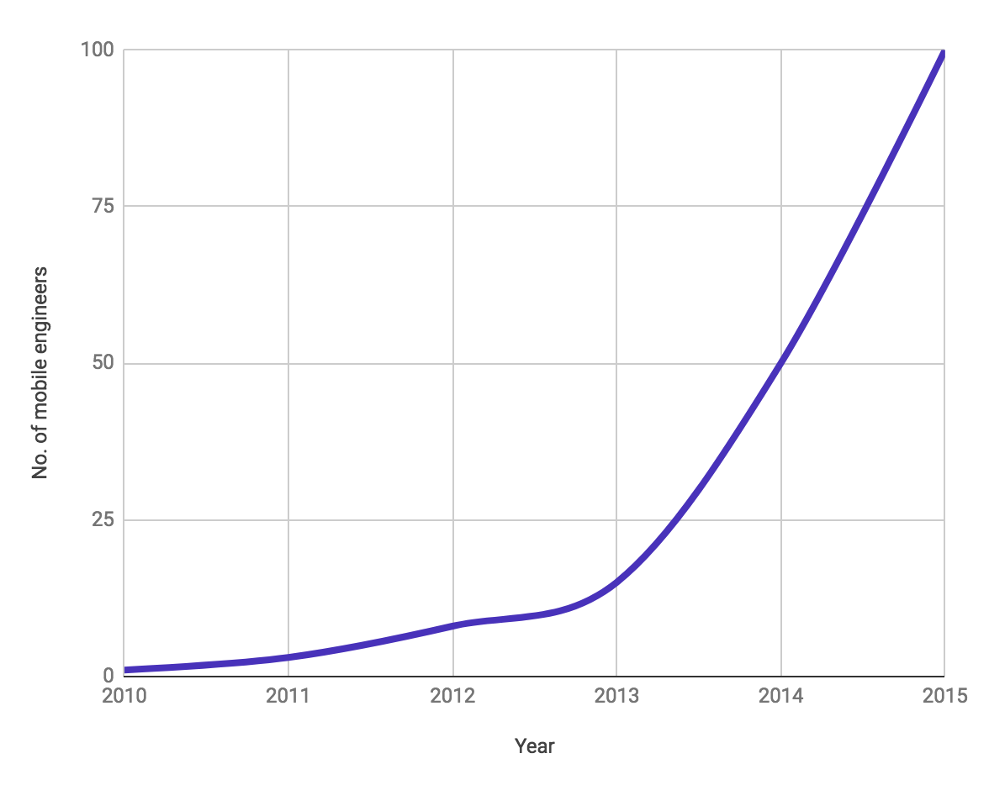
A Growing Team
In 2015 Uber had about 100 mobile engineers working on the same app.

Slide 5
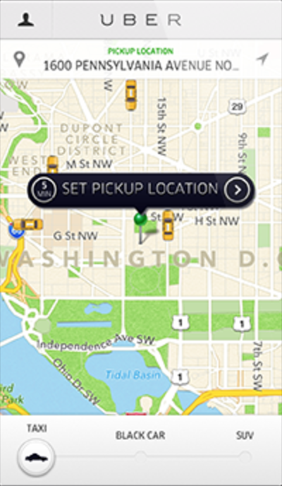
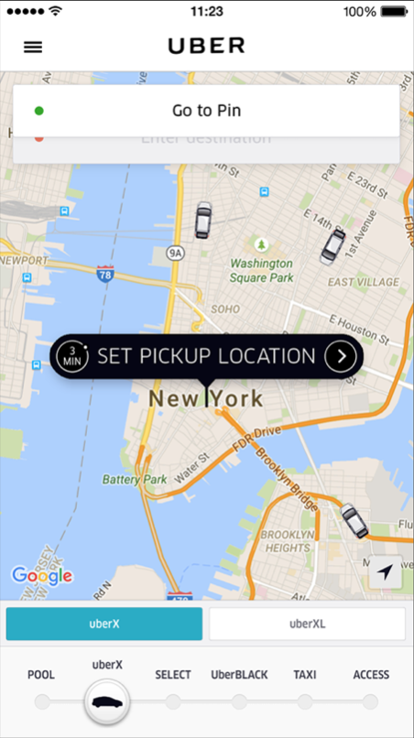
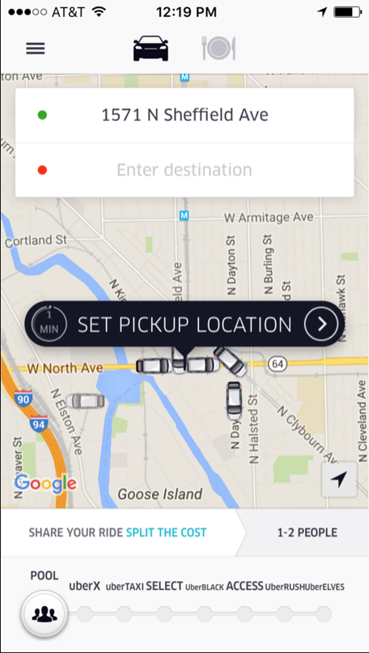
A Growing App

Slide 6
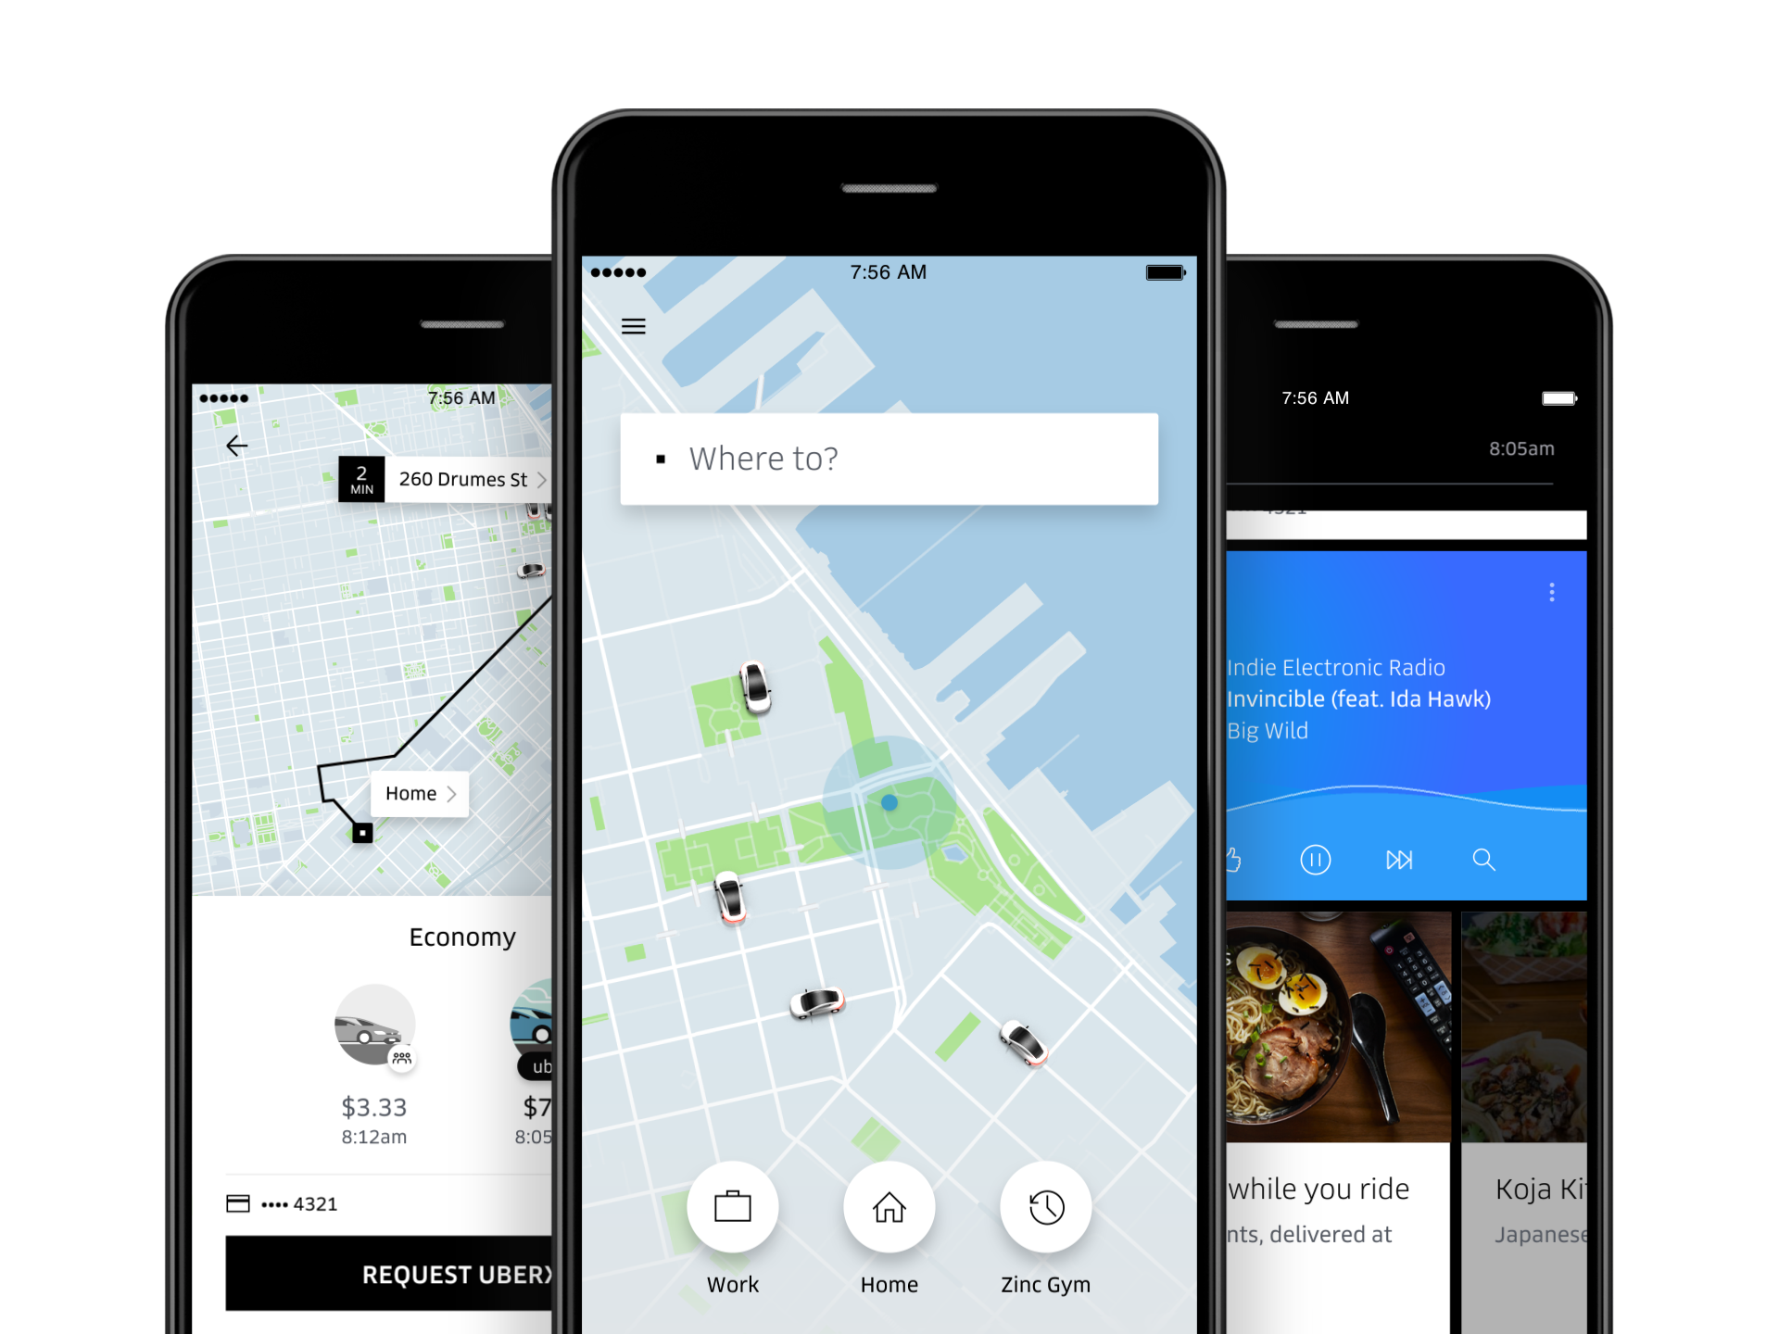
Let’s just change everything

Slide 7
Architecture Goals
General Goals
Uber Specific Goals
Isolation & Testability
Components should be isolated & easy to test.
99.99% reliability of core flows
Support global rollback of core flows to a guaranteed working state.
Developer productivity
Provide rails for architecture and code. Minimize manual, repetitive work.
Monitoring as a first class citizen
Automatic analytics, logging, debugging and tracing.
Support continued growth of a complex app for years
Narrow and de-couple functionality as much as possible.
De-risk experimentation
Feature flagging as a first class feature.
Notes:
Isolation & testability - Changes in one should have little to no affect with another. Developer productivity -

Slide 8
Rewriting the Uber App
January
June
August
November
Core architecture, framework & tooling
Core flow
Everything else
Notes:
Isolation & testability - Changes in one should have little to no affect with another. Developer productivity -

Slide 9
What we Built
Analytics
Testability
Components
Monitoring
Reactive data flows
Experimentation
RIBs Architecture
Application Framework
Logging
Business-logic driven
Plugins
Routing
Scoping
Networking
Dependency management
Storage
Location services
Code generation
Open source
UI components
Notes:
Isolation & testability - Changes in one should have little to no affect with another. Developer productivity -

Slide 10
Motivation
➜
Overview of the Architecture
RIBs in Practice

Slide 11
RIBs
Router
Interactor
Builder
Presenter
View

Slide 12
but we’ll come back to this later

Slide 13
The state management problem
Notes:
Isolation & testability - Changes in one should have little to no affect with another. Developer productivity -

Slide 14
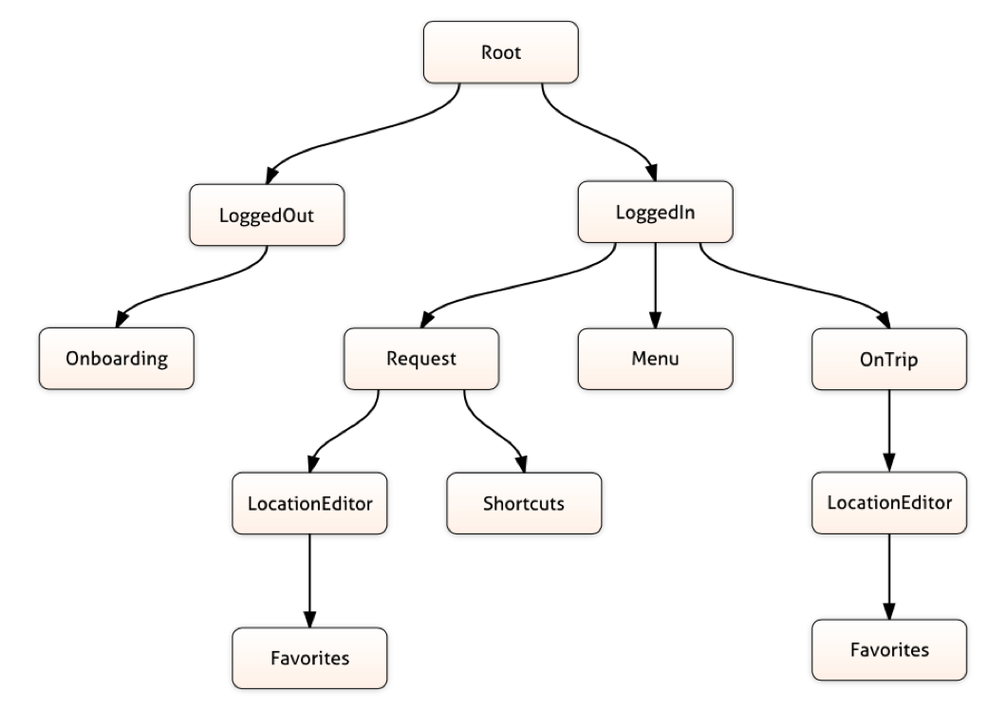
State Tree
Application driven by business logic
Notes:
Isolation & testability - Changes in one should have little to no affect with another. Developer productivity -

Slide 15
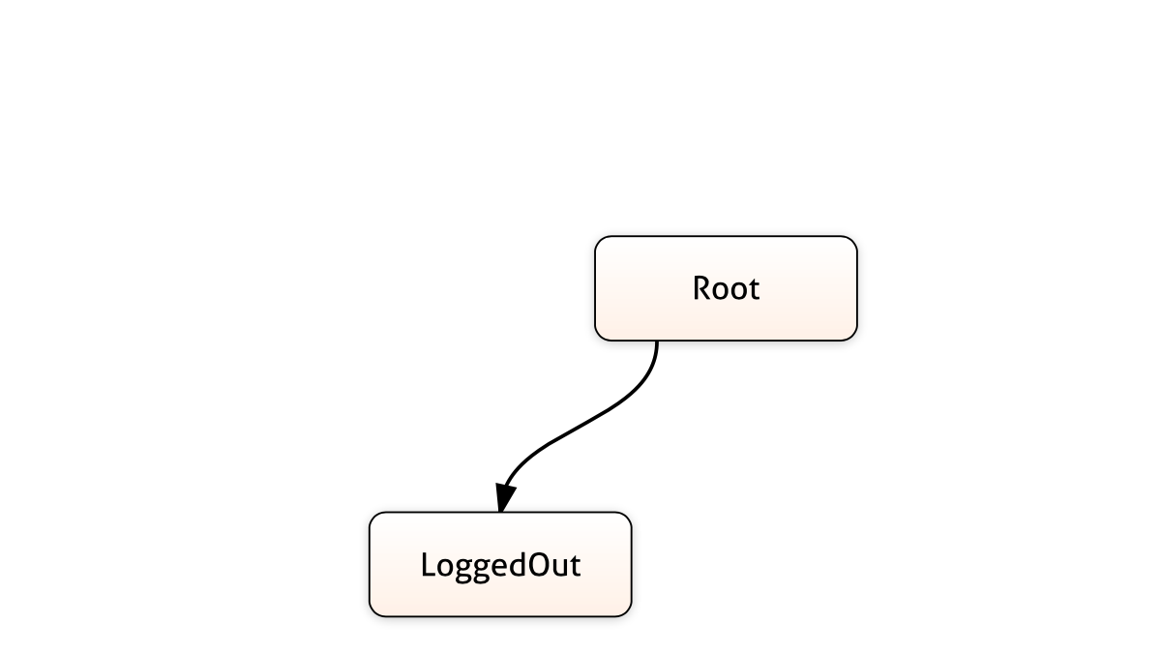
RIBs
State transitions
Notes:
Isolation & testability - Changes in one should have little to no affect with another. Developer productivity -

Slide 16
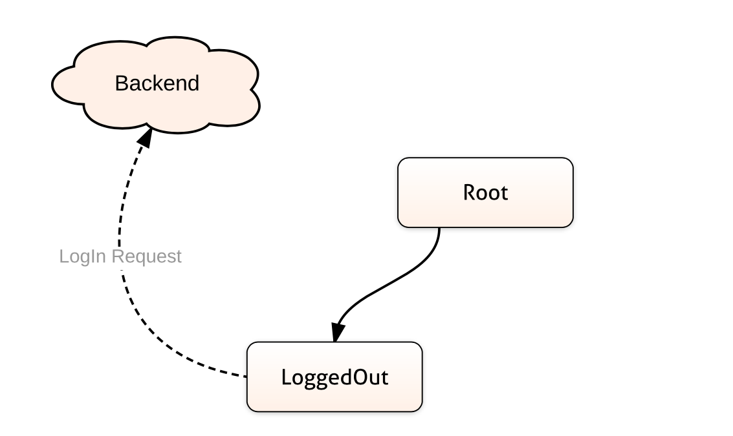
RIBs
State transitions
Notes:
Isolation & testability - Changes in one should have little to no affect with another. Developer productivity -

Slide 17
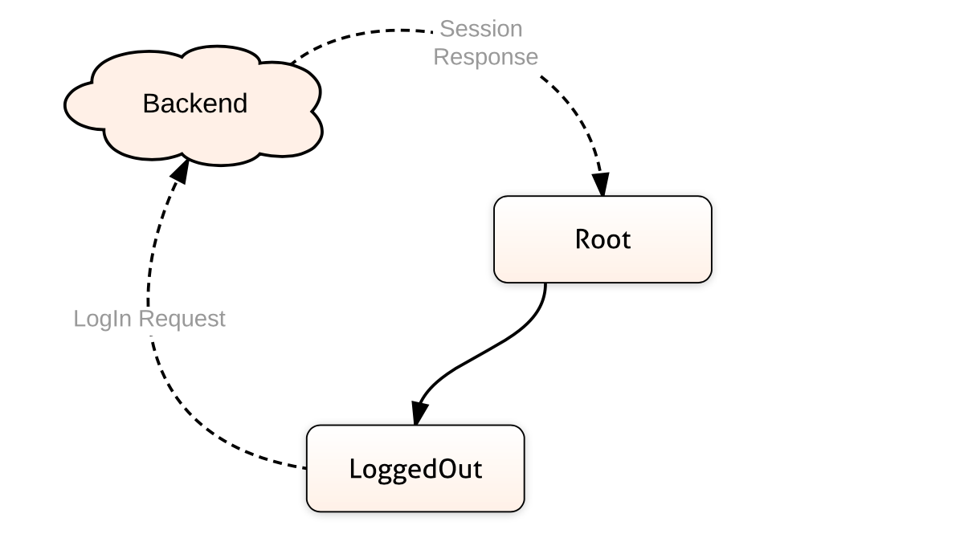
RIBs
State transitions
Notes:
Isolation & testability - Changes in one should have little to no affect with another. Developer productivity -

Slide 18
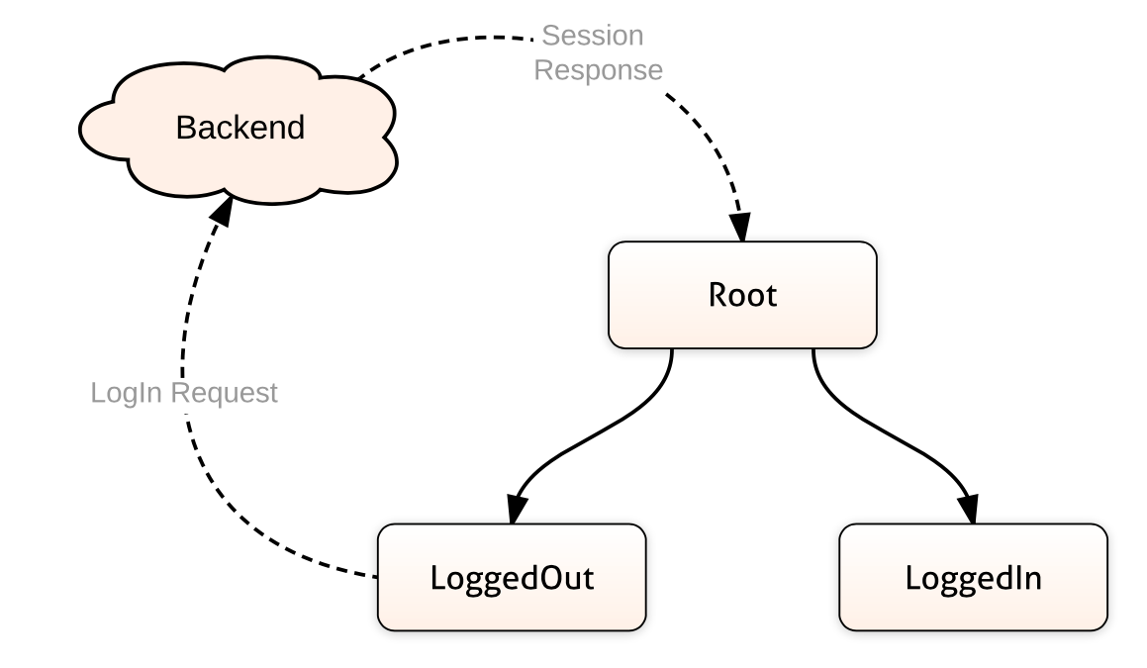
RIBs
State transitions
Notes:
Isolation & testability - Changes in one should have little to no affect with another. Developer productivity -

Slide 19
State Tree
State tree drives the views
Notes:
Isolation & testability - Changes in one should have little to no affect with another. Developer productivity -

Slide 20
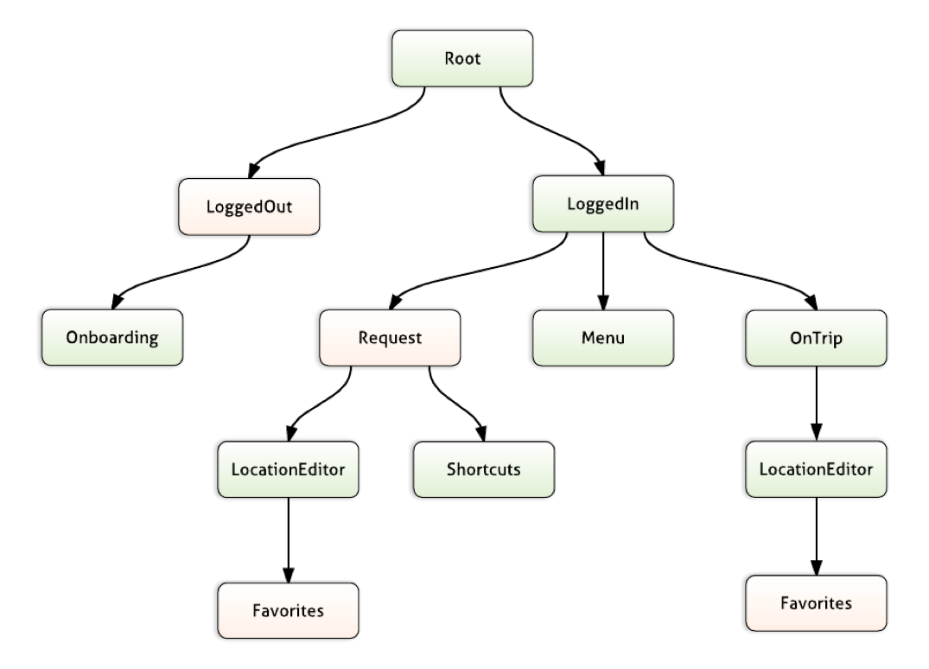
State Tree
State tree drives the views
Notes:
Isolation & testability - Changes in one should have little to no affect with another. Developer productivity -

Slide 21
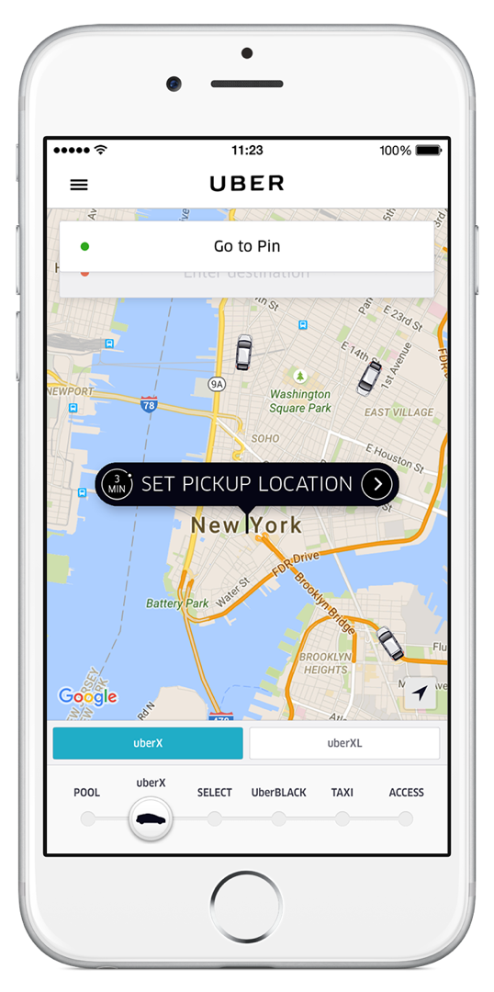
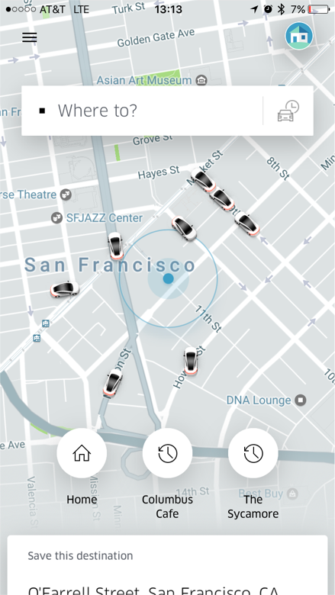
State Tree
State tree drives the views
Notes:
Isolation & testability - Changes in one should have little to no affect with another. Developer productivity -

Slide 22
RIBs
Responsibilities of each component
Builder Builds RIB units
Interactor Business logic of the app (aka “the brain”)
Router Helper for routing between RIBs
Presenter (Optional) Translation Logic
View(Controller) Layout & Animation

Slide 23
Data flow in RIB
Model Stream
Service
The Internets
Pushes state onto
Push/pull
Data model
Service calls
Non-state modifying responses
Interactor
Logic calls
Router
Routing calls
Data model
Presenter
View(Controller)
UI event
View model

Slide 24
Motivation
Overview of the Architecture
➜
RIBs in Practice

Slide 25
What about other architectures?
Truly novel things about RIBs
Things that other frameworks could support
Business logic drives the app, not the view tree
MVC, MVP, MVI, MVVM, VIPER are all built on the assumption that components always have a view
Cross-platform approach
iOS & Android architecture to stay in sync. iOS & Android native developers can review each others’ code.
Independent business logic and view trees
Business logic tree can be deep, but view tree can be shallow.
Developer tooling
IDE plugins for code generation & static code analysis
Opinionated on how state should be communicated
Communicate state down and up the tree, via dependencies.
Notes:
Isolation & testability - Changes in one should have little to no affect with another. Developer productivity -

Slide 26
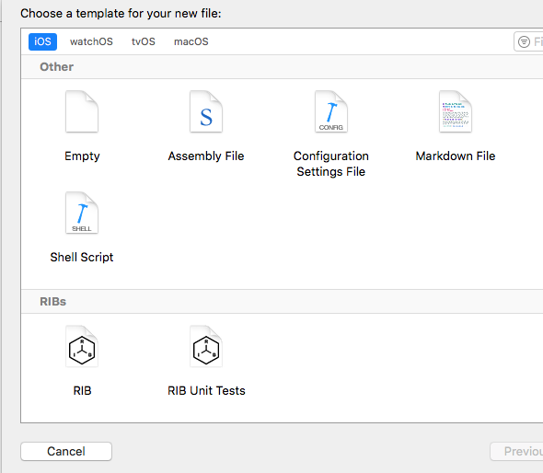
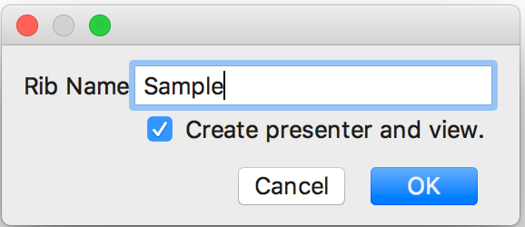
Adopting a new architecture at scale
Rails for architecture & code
Android (IntelliJ, Android Studio)
iOS (XCode)
Notes:
Isolation & testability - Changes in one should have little to no affect with another. Developer productivity -

Slide 27
What RIBs gave us
Rider App
More than 200 engineers across iOS & Android
More than 600 RIBs, many reused in multiple parts of the tree
Less than 300 lines of code per class for most RIBs
Well unit tested business logic

Slide 28
Is this for you?
It depends.
Are you interested in how we built the Uber App(s)?
It’s there to check - and to contribute!
Does your app have lots of non-visual state?
RIBs can structure the app based on business logic, not views.
Do you have a (fast) growing iOS & Android app & team?
RIBs scaled well for Uber. We traded a more heavyweight architecture for better isolation.
uber.github.io
Do you have the bandwidth to invest in a new architecture?
RIBs has a learning curve & tutorials - the same that new engineers at Uber use to learn about them. It also comes with IDE code generation for better adoption for teams.

Slide 29
Thank you
Gergely Orosz
Engineering Manager, Uber Amsterdam
@GergelyOrosz uber.github.com eng.uber.com
uber.github.io

